Slide 1
Week-4
Session-1
●Management and Leadership
oFour functions of management
-Sharing the vision
-Defining mission, goals & objectives
-Types of planning
-Steps of decision making process

Slide 2

TODAY’S MANAGEMENT
*
Managers’ Roles Are Evolving
*
LG1
Management is the process used to accomplish organizational goals through planning, organizing, leading and controlling people and other organizational resources.
7-

Slide 3

FOUR FUNCTIONS of
MANAGEMENT
*
Four Functions
of Management
*
LG2
  Planning
  Organizing
  Leading
  Controlling
7-

Slide 4
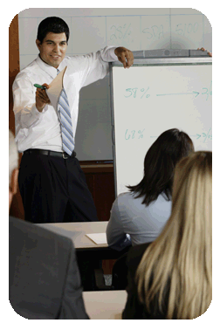
SHARING the VISION
*
Planning & Decision Making
*
Vision -- More than a goal, it’s a broad explanation of why the organization exists and where it’s trying to go. (future)
A mission statement outlines the organization’s fundamental purposes. (present)
Goals are the broad, long term accomplishments an organization wishes to attain.
Objectives are specific, short term statements detailing how to achieve the organization’s goals.
LG3
7-

Slide 5
BRAC
Our Vision
A world free from all forms of exploitation and discrimination where everyone has the opportunity to realise their potential.
Our Mission
Our mission is to empower people and communities in situations of poverty, illiteracy, disease and social injustice. Our interventions aim to achieve large scale, positive changes through economic and social programmes that enable men and women to realise their potential.
Our Values
Innovation
Integrity
Inclusiveness
Effectiveness

Slide 6
Vision
Amazon
"Our [Amazon's] vision is to be earth's most customer centric company; to build a place where people can come to find and discover anything they might want to buy online."

Slide 7
Mission
MISSION
The mission of BRAC University is to foster the national development process through the creation of a centre of excellence in higher education that is responsive to society's needs, and able to develop creative leaders and actively contributes to learning and creation of knowledge. - See more at: http://www.bracu.ac.bd/about#sthash.z6eMkYZA.dpuf

Slide 8
Growing sales revenue in North America can be considered a goal.
Expanding your distribution network is an objective used to reach the goal of raising company revenue.
Examples of Goals and Objectives
Goals ‘“ I want to be a better cricket player. I want to learn more about Chinese history. I want to maximize my professional performance.
Objectives ‘“ I want to memorize the periodic table before my next quiz. I want to increase my sales by 10% this month. I want learn to play ‘Freebird’ on the guitar.

Slide 9
PLANNING ANSWERS
FUNDAMENTAL QUESTIONS
*
Planning & Decision Making
*
LG3
  What is the situation now?
    SWOT Analysis -- Analyzes the organization’s Strengths, Weaknesses, Opportunities and Threats.
  How can we get to our goal from here?
    Strategic planning
    Tactical planning
    Operational planning
    Contingency planning
7-

Slide 10
SWOT
Potential Strengths Market leadership Strong research and development High-quality products Cost advantages Patents | Potential Weaknesses Large inventories Excess capacity for markets Management turnover Weak market image Lack of management depth
Potential Opportunities New overseas markets Falling trade barriers Competitors failing Diversification Economy rebounding | Potential Threats Market saturation Threat of takeover Low-cost foreign competition Slower market growth Growing government regulation

Slide 11

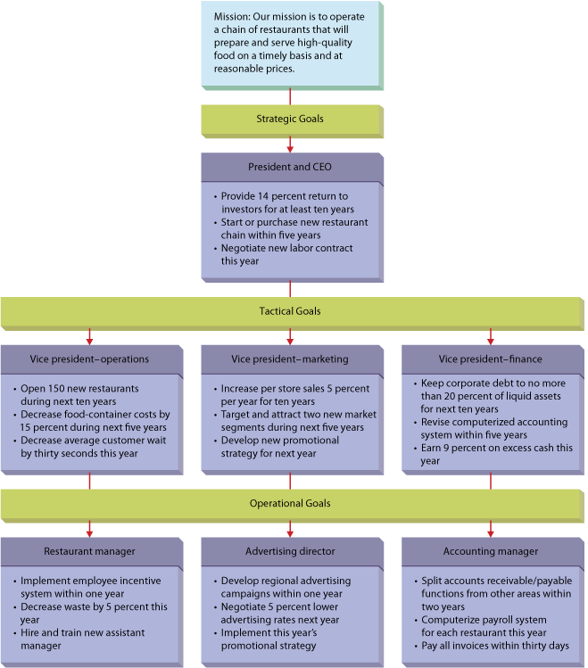
7.2
Kinds of Organizational Goals for a Regional Fast-Food Chain
7–
Notes:
© 2013 Cengage Learning. All rights reserved. May not be copied, scanned, or duplicated, in whole or in part, except for use as permitted in a license distributed with a certain product or service or otherwise on a password-protected website for classroom use.
7–
Management 11e
Griffin

Slide 12
STRATEGIC and TACTICAL
PLANNING
*
Planning & Decision Making
*
LG3
Strategic Planning -- Done by top management and determines the major goals of the organization and the policies, procedures, strategies and resources it will need to achieve them.
Tactical Planning -- The process of developing detailed, short-term statements about what is to be done, who is to do it and how.
7-

Slide 13
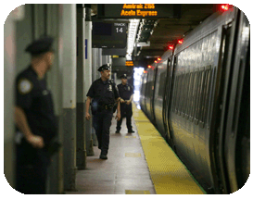
OPERATIONAL and CONTINGENCY PLANNING
*
Planning & Decision Making
*
LG3
Operational Planning -- The process of setting work standards and schedules necessary to implement the company’s tactical objectives.
Contingency Planning -- The process of preparing alternative courses of action the firm can use if its primary plans don’t work out.
7-

Slide 14
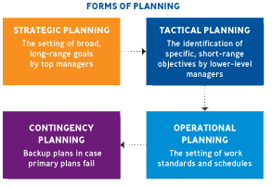
PLANNING FUNCTIONS
*
Planning & Decision Making
*
LG3
7-

Slide 15
RATIONAL DECISION-MAKING
MODEL (7D’s)
*
Decision Making: Finding the Best Alternative
*
LG3
    Define the situation.
    Describe and collect needed information.
    Develop alternatives.
    Develop agreement among those involved.
    Decide which alternative is best.
    Do what is indicated.
    Determine whether the decision was a good one and follow up.
7-

Slide 16
Problem Solving
*
Decision Making: Finding the Best Alternative
*
LG3
    Brainstorming - coming up with as many solutions possible in a short period of time with no censoring of ideas.
    Another technique is called PMI, or listing all the pluses for a solution in one column, all the minuses in another, and the implications in a third. The idea is to make sure the pluses exceed the minuses.
7-

